Slide 1
Historical Road to Maidan Square
LTC Andre Dragomiretzky, USA, RET
31 Oct 2021
Notes:
Copyright (2018) LTC Andre Dragomiretzky, USA, RET
All Rights Reserved.
5 Nov 18, Version 0.99.1: First draft of base presentation.
17 Nov 18, Version 0.99.2: Minor edits for clarity based on first rehearsal.
26 Nov 18, Version 1.0.0: Final edits for Russian 401 class.
31 Oct 21, Version 1.0.1: Date change for St Sergius Presentation.

Slide 2
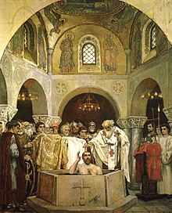
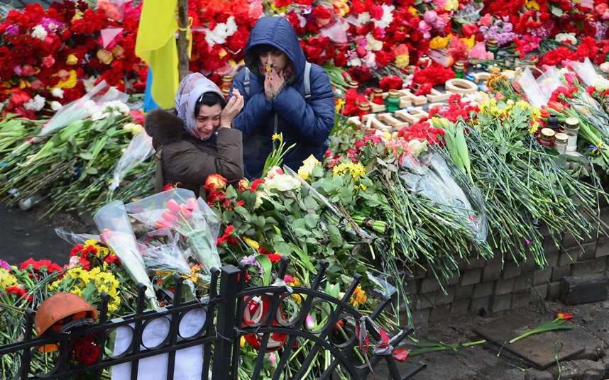
Historical Events and Trends
Significant Historical Events
Long Term Regional Conflicts
From
To
Notes:
Show pictures of two significant historical events, the baptism of St. Vladimir who brought Christianity to Kievan Rus. The second picture is of the impromptu memorial that was set. This presentation will focus on significant events, and historical trends over 1000 years, which set the stage for Maidan Revolution.
Sources:
https://en.wikipedia.org/wiki/Christianization_of_Kievan_Rus%27, 24 Oct 18: for the picture of christening done by Klavdiy Lebedev
https://secure.i.telegraph.co.uk/multimedia/archive/02833/ukraine-kiev-flowe_2833396k.jpg , 28 Oct 18)

Slide 3
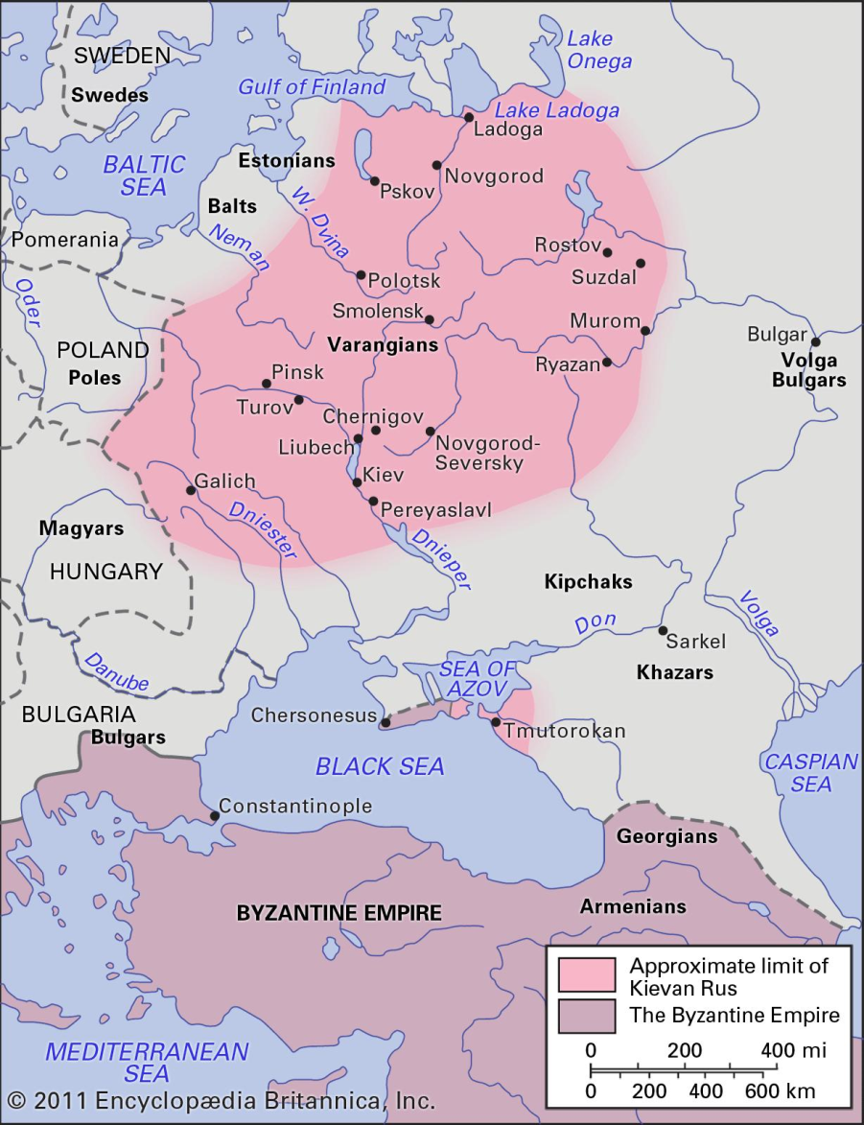
Kievan Rus Prior to 988
Feudal
Polythestic
Rod / Rid
Belobog (male / day / light)
Chernobog (female / night, dark)
Perun
Many others
Notes:
Purpose for this slide is to provide background what Kiavan Rus was prior to the christening in 988 of the scope and size of Kievan Rus, as well where it was geographically. This map is mostly accurate for the period of 862 to about 1123.
Explain that this was more or less the territory at around 1100 AD, the zenith of Kievan Rus
Some gods were regional, some spanned several regions but had different names. Each god did have a specific symbol.
If ahead on time, explain that Rod / Rid was the leader of the Pantheon, B & C where deities which focused on opposition (man vs woman, day vs night, light vs darkness), and Perun was a cross between the Nordic Thor and Greek Zeus
Sources:
https://www.britannica.com/topic/Kievan-Rus, 17 Oct 18
https://en.wikipedia.org/wiki/Deities_of_Slavic_religion for deities and their symbols, 17 Oct 18

Slide 4
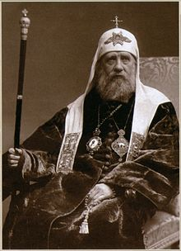
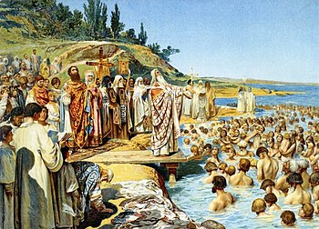
988
Saint Vladimir ruled 980 from 1015
Allied with Byzantine empire
Notes:
Key here is Christianization of Kievan Rus was initiated due to politics, by request for assistance from Basil II of Byzantine. Vladimir accepted Christianity and a year later christened the Rus. What this did was neutralized the threat in the southeast, with the creation of the Ottoman empire.
Third conical cap patriarch is a bit of historical trivia. The first Popes in Rome wore a conical cap, at some time later Roman popes stopped wearing it and it was worn by the Patriarch of Constantinople. After the fall of the Byzantine empire, the patriarch of Moscow wore it, until the fall of Imperial Russian. This also shows that Christianity has lasted in both the Ukraine and Russian for over 1000 years.
This is the first significant event.
Sources:
https://upload.wikimedia.org/wikipedia/commons/thumb/b/b5/Tikhon_of_Moscow.jpg/220px-Tikhon_of_Moscow.jpg, 4 Nov 18
https://en.wikipedia.org/wiki/Christianization_of_Kievan_Rus%27: The Baptism of Vladimir, a fresco by Viktor Vasnetsov (downloaded 24 Oct 18)

Slide 5
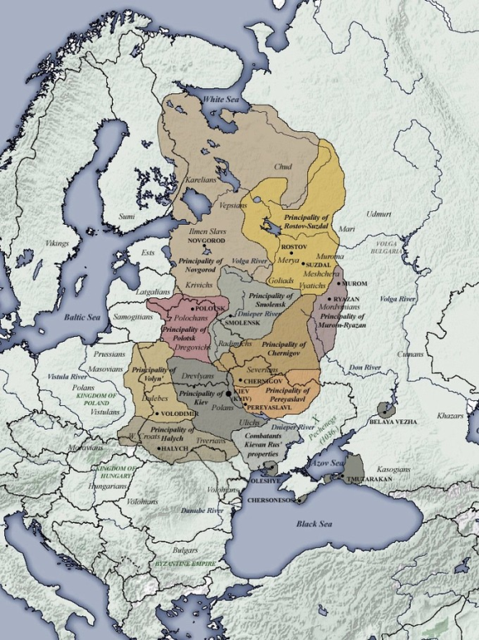
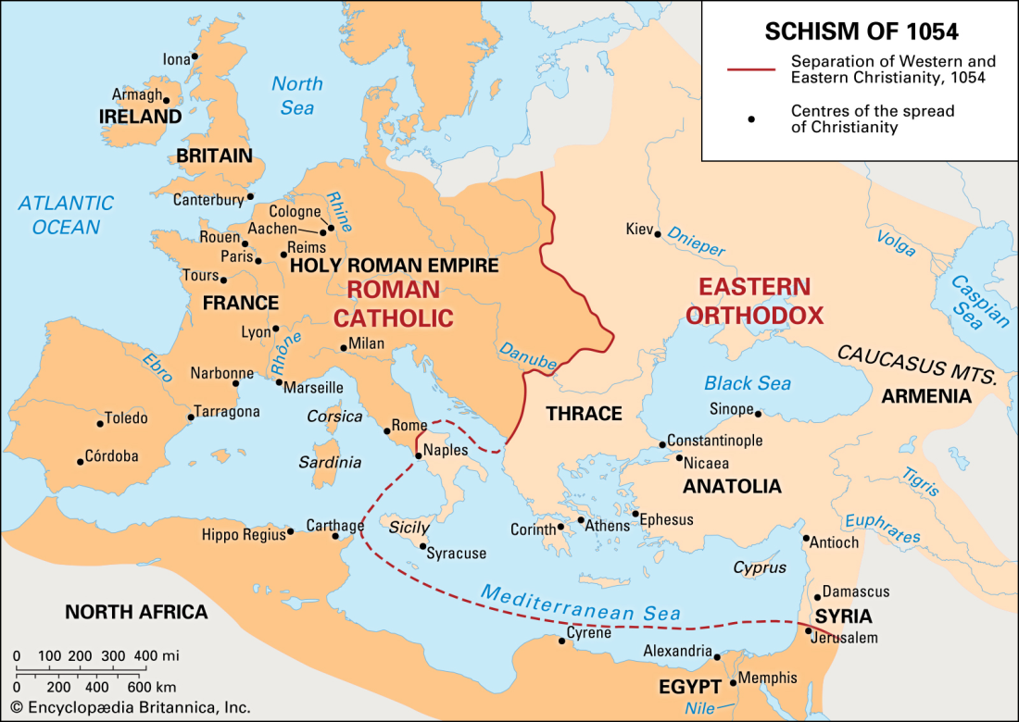
1054
The Great Schism between Catholic (west) and Orthodox (east) churches
Notes:
This event, will become much more important later in history. This is the second significant event, a religious fault line right through what is today Eastern Europe.
First map is what part or Christianity remained under the pope, and what part was under Constantinople.
The map on the right roughly shows feudal boundaries of the various city states.
This is the second significant event
If ahead on time:
This schism is the result of the break up of the old Roman Republic into two administrative districts, one based out of Rome and the other out of Constantinople about 600 years ago. At that time there was one patriarch in Rome, and four within the Eastern administrative area.
Sources
https://courses.lumenlearning.com/suny-hccc-worldcivilization/chapter/the-mongol-threat/, 22 Oct 18, for the map of Kievan Rus from 1054 to about 1132.
https://www.britannica.com/event/Schism-of-1054/media/587056/226254, 22 Oct 18, is the map of Eurasia showing the great schism

Slide 6
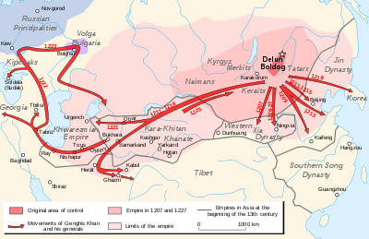
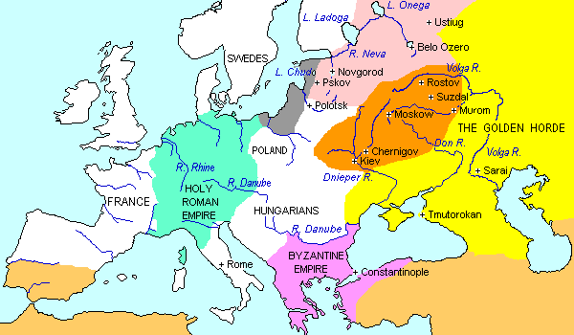
Mongols
1223 - Ghengis Khan
1237-1242 - Batu Khan
Polish & Lithuanian influence SW
1480 Great Stand on Ugra River
Notes:
Mongol rule lasted for 240 years, and the significant effect was a cultural division of Kievan Rus into mostly into the north (Belarus) Novgorod / east (Russian) Moscow / west (Ukraine) Kiev
Key here is to point out where the boundary is of Russia and Poland on the map of 1250, and that is where the cultural divide is currently today between East and West Ukraine centering on Kiev located mostly the west.
During this time Moscow gained prominence with the Mongol’s blessing. Kiev turn to the west (Poles and Catholics) for support. A cultural and religious fracture was made within what is Ukraine today.
First long term event.
If ahead on time:
Explain that there was a Mongol custom when there was a change in leadership, the leaders had to travel back to pledge allegiance to the new leader. Sarai was the seat of Mongol Rule in the west. Kievan Rus Population prior to the Mongol invasion was 7.5M.
Sources:
Map is from https://en.wikipedia.org/wiki/Genghis_Khan, 22 Oct 18
Second map is from http://www.drshirley.org/geog/geog30.html#tartar, 22 Oct 18

Slide 7
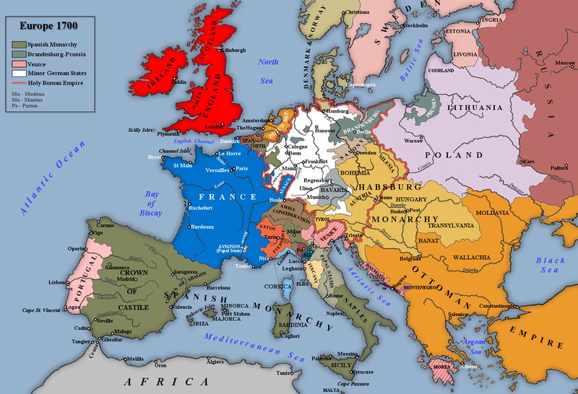
North Western Wars
1582-1583 Livonian War
1590-1595 Russo Swedish War
1609-1618 Polish-Moscovite War
1632-1634 Smolensk War (Poland)
1654-1667 Russo Polish War
1656-1658 Russo Swedish War
1700-1721 Great Northern War (Sweden)
1741-1743 Russo Swedish War
1788-1790 Russo Swedish War
1792 Polish Russian War
1808-1809 Finish War
1831 Battle of Warsaw
Notes:
Key points is to explain that Lithuania, Sweden, Poland were major powers in Central Europe during that time. Who started the war is not important, what is important here, is that over the 200-250 years of off and on wars, there was a lot an ancestral miss-trust developed on all sides.
The map is of Europe and Western Russian circa 1700-1714, during the reign of Peter the Great. Notice that for the most part Russia did not have a access to either the Baltic Sea nor the Black Sea. Peter the Great established St. Petersburg on the Neva river as capitol, first to take a poke at Sweden, and second to set up a major port with access to Baltic Sea.
Also note who controls what is currently eastern Ukraine, west of Kiev is owned the Poles.
First series of related events.
Sources:
https://commons.wikimedia.org/wiki/File:Europe,_1700%E2%80%941714.png, 30 Oct 18
List of wars is from multiple sources

Slide 8
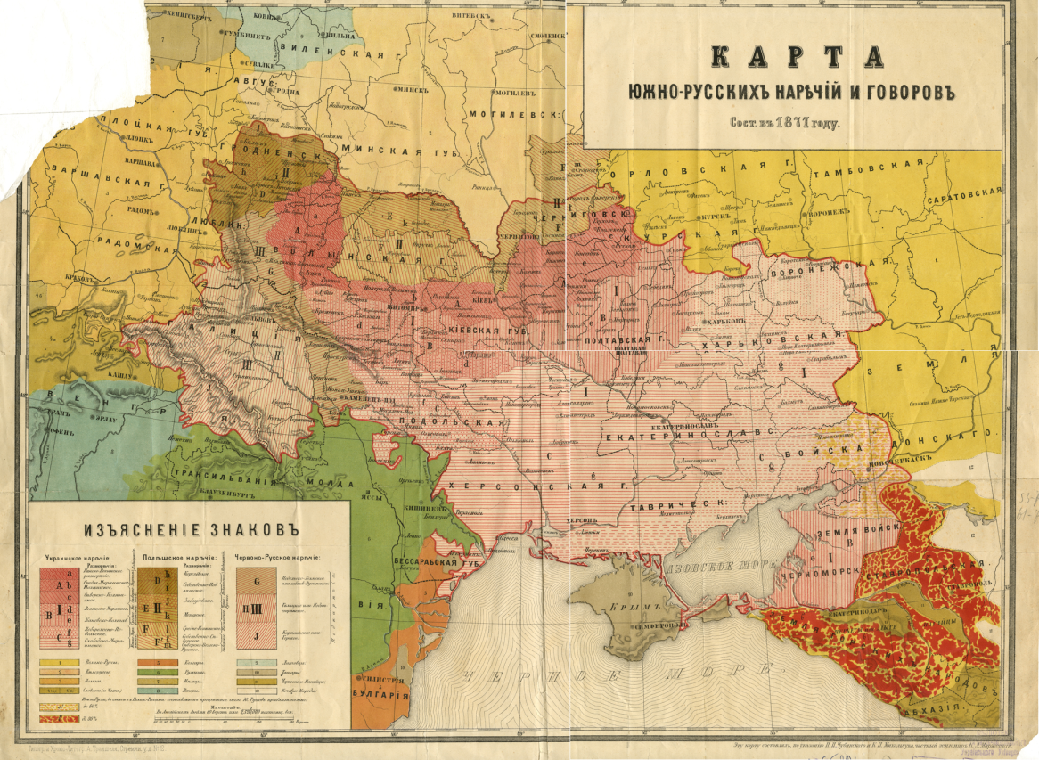
South Western Wars
Russo-Turkish Wars
1568-1570
1676-1681
1686-1700
1710-1711
1735-1739
1768-1774
1787-1792
1806-1812
Crimean War 1853-56
World War I 1914-18
Notes:
Contrast this with what was going on in England, Spain, Portugal, and France at this time, and how they became world powers, due being naval powers, hence Peter the Great, made a major goal to get a warm water port, i.e. Black Sea / Azov Sea, i.e. the Donbas. This started the expansion to the south. At the same time, the Ottomans were trying to expand their empire. Emphasize the number of South Western wars from 1676 forward.
On the map, point out the red is what was Ukraine. South of that, along the Black see is predominantly Russians. This map is accurate for various oblast boundaries, but it is also fairly accurate for the cultural divisions from the year 1871.
If ahead on time, focus on the lettering and map.
This is a Russian/Ukrainian map from that time period. The way to identify is via the lower case “I” with the dot or double dot, like the Russian letter “yo” over it, which is distantly part of the Ukrainian alphabet. The map can be dated with the letter “yat” which as one of 4 letter removed from the Russian alphabet in 1918.
Second series of events.
Sources:
https://www.realclearhistory.com/articles/2018/06/14/10_most_important_russo-turkish_wars_323.html providing the list wars between Ottomans / Turks and the Russians, 30 Oct 18
Map is from http://likbez.org.ua/wp-content/uploads/2014/10/chubinski-mykhalchuk.jpg, 4 Nov 18

Slide 9
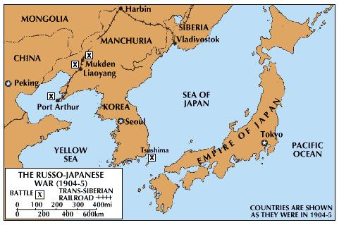
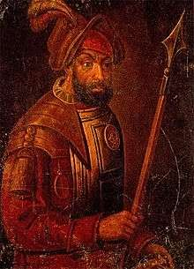
Eastern Wars
1585 - Ermak Timofeevich
1904 – 1905 Russian – Japanese war
1945 - WW II
Notes:
Ermak, during Ivan the Terrible’s reign was a Cossack who with 50 other Cossacks started the conquest of Sibera. He was drowned while trying to swim across following a military defeat. Some historians consider him Russian explorer.
Emphasize that the Russian-Japanese war that this was done at the prodding from Imperial Germany (https://www.jstor.org/stable/pdf/1835392.pdf) and an example of the secret diplomacy that was in Europe prior to WW I, that lead to the Russian defeat of the Russian Japanese War. Neither Japan nor Russia really wanted to conflict to escalate. This war weaken Russian which was an ally of France, and Japan which was an ally of England, in an attempt to force Russian into closer ties with Germany.
Russia lost south Sakhalin Island which was acquired in trade for the Kiril islands in 1875. Port Arthur and the Manchurian railway was also lost as a result of the that war.
Provided as contrast as to conflicts in east from after the Mongol invasion to just after WW II
If ahead on time:
The other historical trivia is that Japan attacked Port Arthur in 1904, three hours before the declaration of war delivered to Tsar Nicholas II
WW II why list WW II for only 1945? Simple. USSR had a non-aggression pack with Japan until the last few days of WW II. The only reason the USSR declared the war on Japan was that it was an ally and the allies had already beaten Germany, in May 1945. USSR declared war on Japan on 9 August 1945. The two atomic bombs were dropped on Japan on 6 August and 9 August 1945. As a result of WWII, USSR gained the Southern Kurils
Some historians say that the one-two punch of the second atomic bomb and Russia’s declaration of war on Japan on 9 Aug is why Japan unconditionally surrendered to the allies.
Sources:
https://en.wikipedia.org/wiki/Yermak_Timofeyevich#/media/File:Yermak_Timofeyevich.jpg, 1 Nov 18
https://www.britannica.com/event/Russo-Japanese-War/media/514017/109273, 1 Nov 18

Slide 10
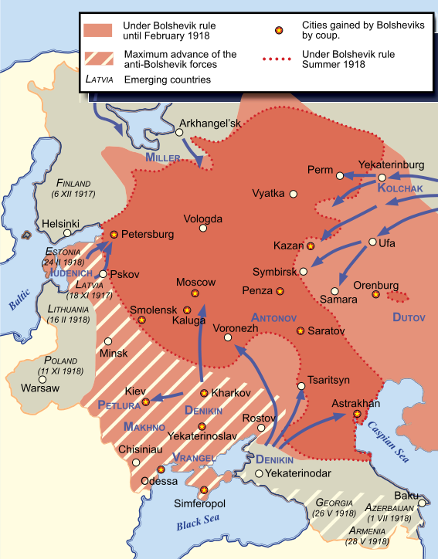
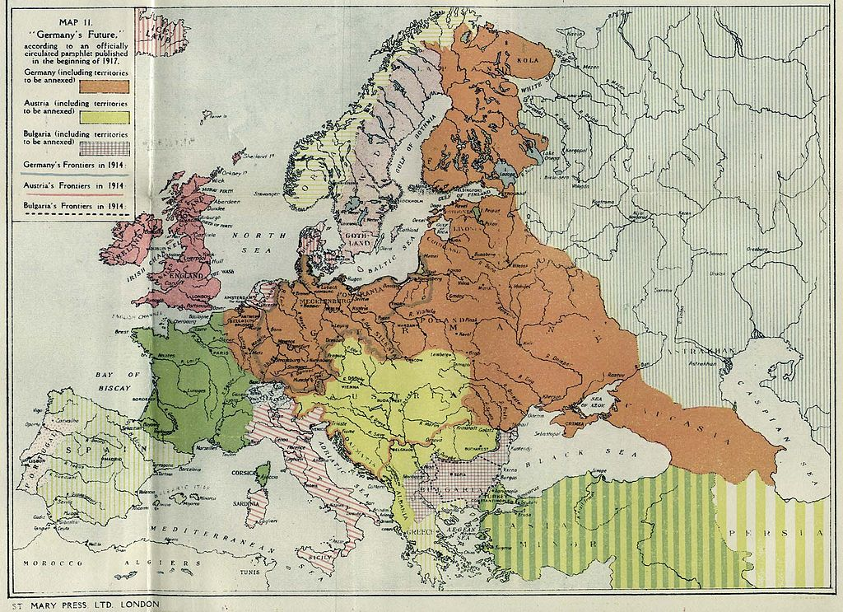
20th Century
1914-1917-18 WWI
1917-1922 Russian Civil War
Post Civil War to WWII
1954 – Crimea
1991 – Commonwealth of Independent States
Notes:
WWI ended for Russian and setting up of Ukraine as separate from Russia
While talking about the Russian Civil War, explain that the Bolsheviks had to reconquer most of the territory, after the end of WWI.
Republics were formed with no ethnic majority. Note Crimea was initially assigned to RusSSR
Talk about the failure of Communism and starvation of the Ukrainian people particular in the 1930’s and how could of inflamed the Ukrainians against the Russians (Moscow)
Administrative transfer of Crimea was done for political reasons, to increase number or cultural Russians within Ukraine
Finishing touches to solidifying the political, linguistic, cultural, and in small part religious fault line.
Sources
https://en.wikipedia.org/wiki/Territorial_evolution_of_Germany#/media/File:Germany_future_1917.jpg, 3 Nov 18
https://en.wikipedia.org/wiki/Russian_Civil_War#/media/File:Russian_civil_war_in_the_west.svg, 3 Nov 18

Slide 11
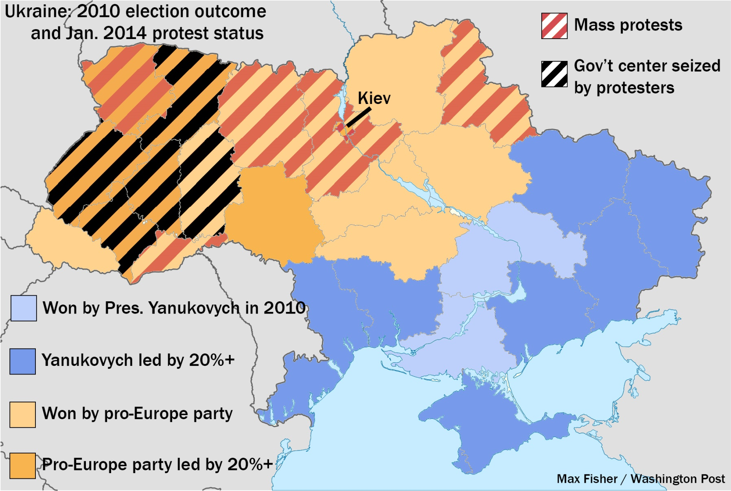
Situation in Ukraine Late 2013
Notes:
Highlight the difference between the Eastern and Western parts of Ukraine. Tie in the difference of religion i.e. Catholic (east) vs Orthodox (west). Closer ties to EU (east) vs Russian Federation (west)
Focus on the difference of attitudes, which was set in 988, and further changed by the Mongol invasion, and the long term regional conflicts amplified for political reason with what was done by the Soviets.
Avoid / punt questions of who did what to whom just prior the Maidan Revolution and the ongoing conflict.
Source:
http://www.washingtonpost.com/blogs/worldviews/wp/2014/01/24/this-is-the-one-map-you-need-to-understand-ukraines-crisis/, 29 Oct 18, … by Max Fisher

Slide 12
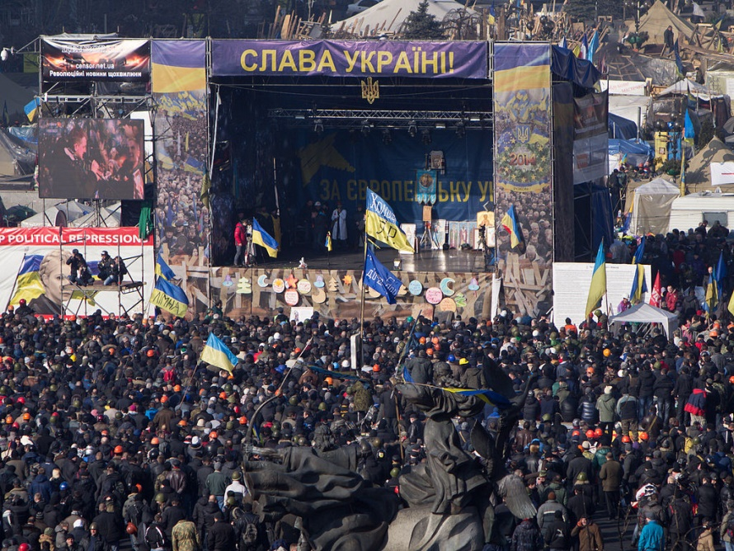
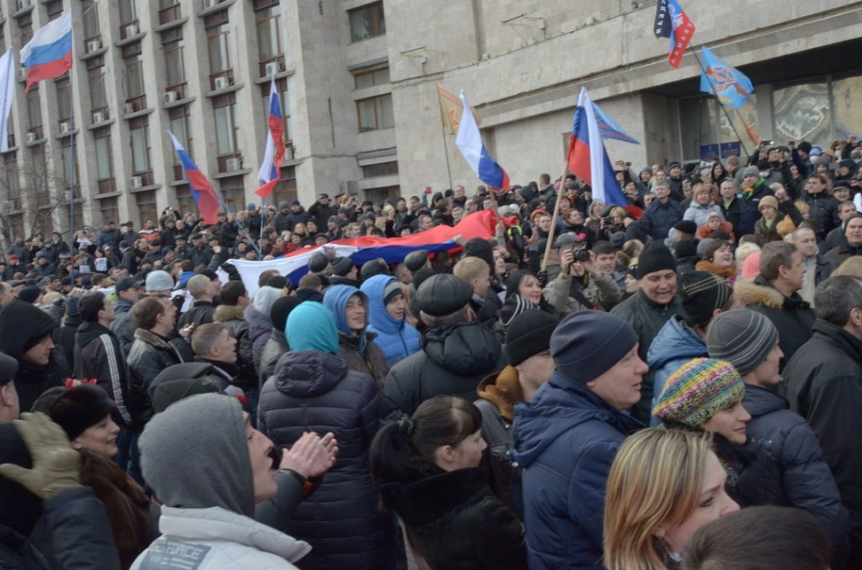
Questions
1000 years of history
Along one of histories fault lines
Notes:
Conclusion and questions, explain that history continues, based on map and history that there would be conflict between the eastern and western parts of Ukraine.
Focus on the different flags Ukrainian vs Russian. Both pictures are in Ukraine, Kiev and Donesk, and how the residents of both cities self-identify.
Sources:
https://en.wikipedia.org/wiki/2014_Ukrainian_revolution, 26 Oct 18, is the source of both pictures

